Slide 1
AI Sign Language System
An innovative approach to assist the visually impaired community using AI technology.

Slide 2
Introduction
This presentation introduces an AI-powered sign language system designed specifically for the visually impaired. It aims to bridge communication gaps by utilizing cutting-edge technology to translate sign language into a perceivable format.

Slide 3
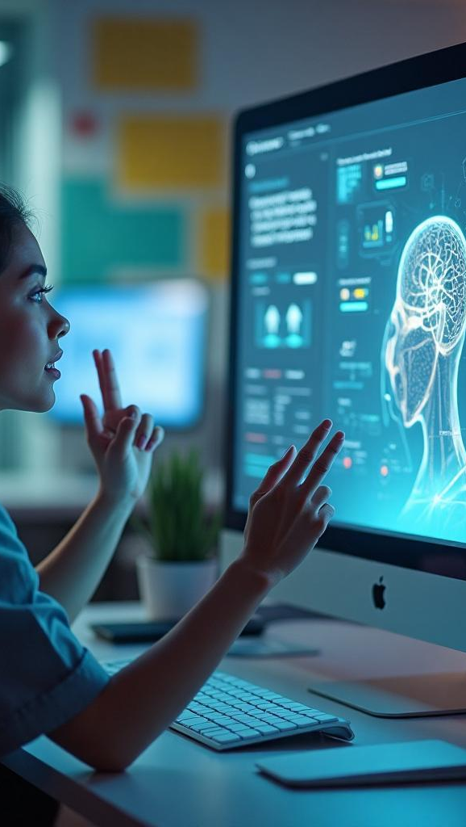
01
Introduction to AI Sign Language

Slide 4
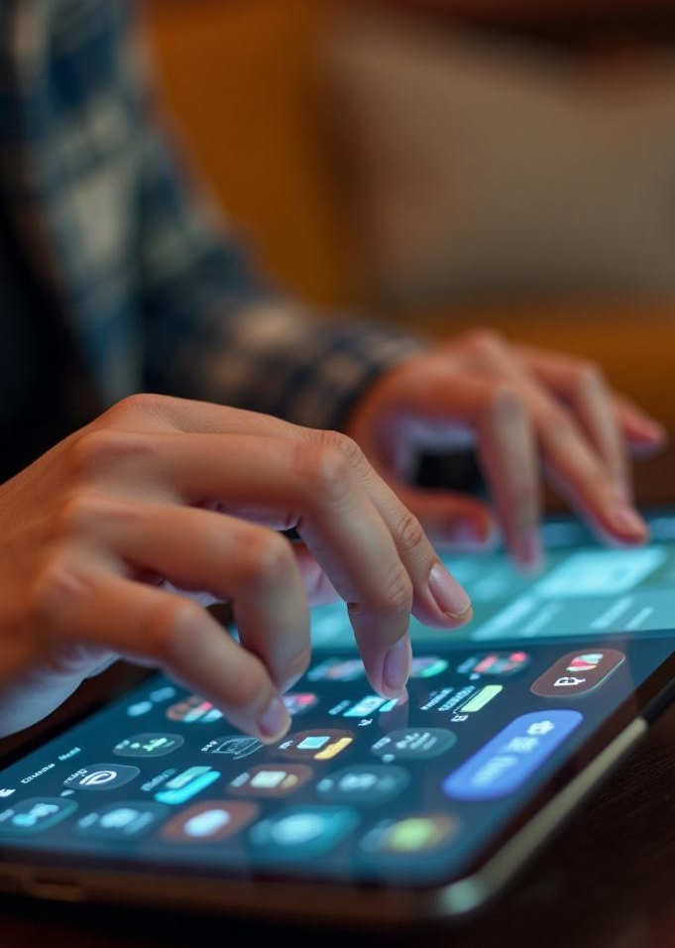
Definition and Purpose
The AI sign language system is an advanced tool that interprets sign language gestures into spoken or written words, enabling effective communication for visually impaired individuals. Its purpose is to enhance inclusivity and accessibility in various settings, from educational institutions to everyday social interactions.

Slide 5
Technologies Used
The system utilizes machine learning algorithms, computer vision, and natural language processing to accurately recognize and translate sign language. Key technologies include deep neural networks for gesture recognition, voice synthesis engines for audio output, and mobile applications for user interaction, making it a versatile tool for various environments.

Slide 6
Target User Group
The primary users of the AI sign language system are visually impaired individuals who require assistance in communicating via sign language. Additionally, this system can benefit educators, caregivers, and peers, fostering an inclusive environment where communication barriers are minimized.

Slide 7
02
System Functionality

Slide 8
Real-Time Interpretation
The system is capable of real-time sign language interpretation, allowing users to engage in live conversations. Using advanced algorithms, it quickly processes sign gestures, converts them to spoken language, and delivers audio output, ensuring seamless communication flow.

Slide 9
User Interface Design
The user interface is designed to be intuitive and user-friendly, prioritizing the needs of visually impaired users. Features include voice navigation, tactile feedback, and simple iconography to facilitate easy interaction with the system, thereby enhancing user experience.

Slide 10
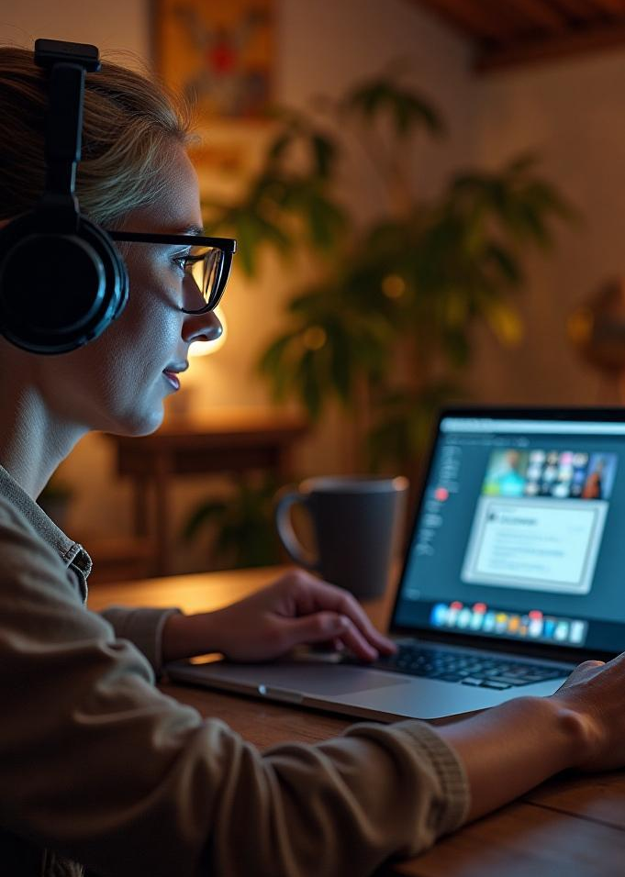
Accessibility Features
The system incorporates various accessibility features, such as compatibility with screen readers, customizable voice options, and adjustable speech rates. These elements ensure that the tool is accessible to a broader audience, including those with varying levels of visual impairment and literacy.

Slide 11

Conclusions
The AI-powered sign language system represents a significant advancement in communication technology for the visually impaired. By integrating real-time interpretation, user-friendly design, and robust accessibility features, it plays a crucial role in promoting inclusion and enhancing social interactions.

Slide 12
Thank you!
Do you have any questions?
+91 620 421 838

